Slide 1
Training for Technical Session Organizers
Notes:
Welcome to MyTechZone Training for Session Organizers. If you are interested in authoring or reviewing, please be sure to visit the presentation files for these volunteer roles.
I will be taking you through an overview of MyTechZone, a tool used by authors, organizers, reviewers and SAE staff

Slide 2
Training for Technical Session Organizers Table of Contents
Understanding the Paper Development Process
Evaluating Abstracts
Moderating the Review
Approving the Paper for Publication
Assigning Presentation Times
Reviewing Presentations
Preparing for On-Site

Slide 3
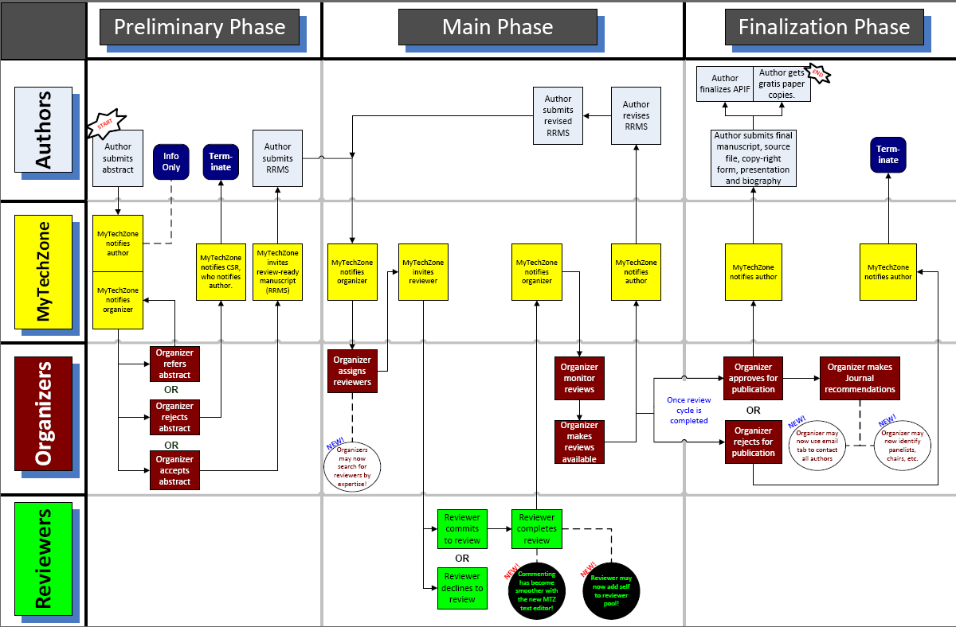
Technical Paper Process
Notes:
This is the technical paper process flowchart that we will be walking through today.

Slide 4
Today’s Training
Review screens that SAE session organizers, authors, reviewers and staff will use.
On-site roles / responsibilities
Current Deadlines
Notes:
This presentation will show you the screens that you will be using most in chronological order throughout the paper development and review process.

Slide 5
Notes:
SAE’s MyTechZone is proprietary, online software created by SAE for the use of our volunteers in facilitating the technical paper and presentation review process., paper and session development
Where you see the logo, live to link to mtz

Slide 6
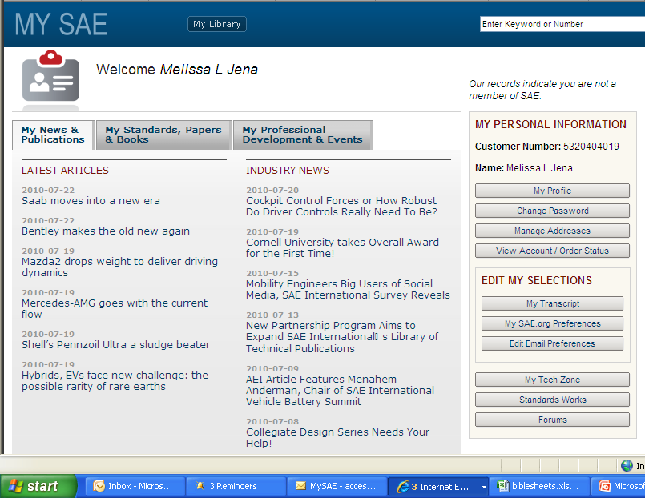
Accessing MyTechZone
http://volunteers.sae.org/
www.sae.org
Contact SAE Customer Service for login issues
CustomerService@sae.org
1-877-606-7323
724-776-4970
http://my.sae.org/
Event Website
Notes:
There are several ways to access MyTechZone.
SAE Event home page
SAE Home page under publications/authors
http://volunteeers.sae.org
MySAE
www.sae.org/mytechzone

Slide 7
Session Descriptions
Prior to launching the call for papers, organizer enters session description in MyTechZone
Max character count - 500

Slide 8
Critical Deadlines
31 weeks prior to event – call for papers deadline
25 weeks prior to event – review ready manuscripts
8-10 weeks prior to event – sign off copyright/
final manuscript
Refer to meeting specific event website
for detailed critical deadlines

Slide 9
Abstract Submission
Call for papers
Author uploads abstract into MyTechZone
Author self -selects session (and can now view session descriptions)
Adds author, co-authors, corresponding contacts and their affiliations
Notes:
Based on the call for papers, the author logs in to the website and uploads his/her abstract submission. Self selection of a session is required.
Main Author or Corresponding Contact can upload or change information. (not co-author)

Slide 10
Abstract Submission
NEW
Automatic notification sent via email
Notes:
Upon submission the Author, Organizer and Staff Rep are copied in an e-mail
MTZ has been updated recently to enable the authors to view the Session Description of the Session prior to uploading their abstract. This helps to ensure that the author submits to the correct session

Slide 11
Organizer Initial Process
Organizer receives an e-mail notifying that an abstract has been submitted to his/her session.
Organizer accesses MyTechZone and navigates to their session home page. Then, organizer selects View Pending Papers.
Organizer clicks on Abstract tab and reads abstract. Organizer then accepts, refers to another session or event, or rejects the submitted abstract.
Notes:
Here’s how the paper review process begins.
Communication and meeting deadlines is important!!!

Slide 12
Navigation to Pending Abstracts
Notes:
This is the succession of screens that you’ll see when handling abstracts.
First (upper left corner) you see the MTZ login page (use your regular SAE user ID and password).
Next (upper right corner) you’ll see a list of the sessions for which you are serving as organizer and/or staff REP.
Third (lower left corner) you’ll see your session home page, where you can click the “Pending Papers” button to see abstracts that have been submitted to your session.
Last (lower right corner) you’ll see the page with the list of abstracts currently pending for your session.

Slide 13
Evaluating Pending Abstracts
Automatic notification sent via email
Notes:
Once you’ve selected the individual abstract, you’ll come to the details page for that abstract. You’ll see the basic information for the page displayed. Select the Abstract tab.
Here you’ll see the full text of the abstract, and you may either:
Accept the abstract (causing MTZ to invite the author to submit a manuscript)
Reject the abstract (not appropriate for this conference)
Refer the abstract (send it to another session within the conference)
When finished, select the Submit Abstract Evaluation button.
Abstracts should be reviewed as soon as possible upon receipt to allow authors the maximum time to write a quality manuscript for review.

Slide 14
Author Only View Uploading Review Ready Manuscripts
Notes:
This is the screen an author sees once he/she logs in to upload their manuscript. They sign off the export control compliance statement then upload a PDF file of their manuscript. They
During submission of the Final approved manuscript, they must first agree to the terms and conditions under the copyright statement tab

Slide 15
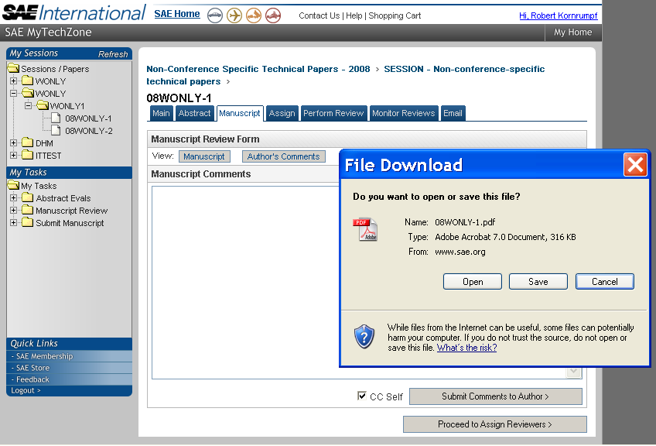
Viewing the Manuscript
Notes:
Once an author has submitted a manuscript, an email notification is sent to all the organizers of the session. The organizer may use this tab, and button, to view it. The manuscript may be viewed directly in a separate window, or may be downloaded to the user’s computer.
It is up to the organizers discretion if they wish to extend the review ready manuscript deadline. It is not recommended; however many organizers allow up to a 2 week extension.
If you see the author has not followed the SAE template (single column, no author listing), please bring this to their attention.

Slide 16
Assigning Reviewers
Do not search using only email as your criteria
Notes:
At least 3 reviews are required for all technical papers.
The Reviewers tab is used to find and select reviewers for the papers in your session. There are three ways to search:
By last name, first initial, email, etc.
By list of those you’ve selected as preferred (see next slide)
By expertise (any or all selected)
Search by last name and email first (do not include email address)
If a common name, can add email to the criteria

Slide 17
Reviewers not in SAE database
This will ask the reviewer to create a new login on the SAE website.
Notes:
If you know the reviewer is in the SAE website and you get a return like this, click the back button to search again or contact SAE for assistance.
Upon mouse click..
This is the screen shot of what the reviewer search screen looks like when finding a valid SAE customer in the SAE database.

Slide 18
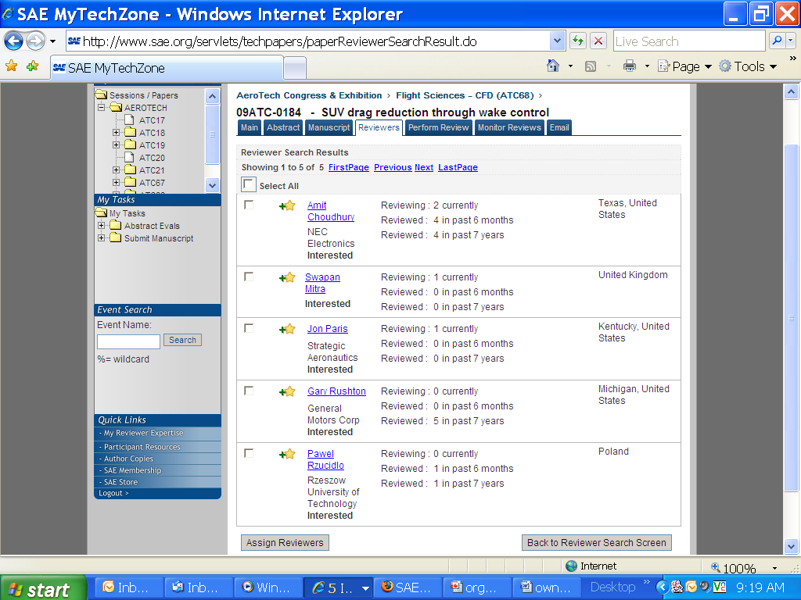
Preferred Reviewers
Notes:
After searching by name or expertise, you will receive a results page like this. You may use any of the “plus-star” icons indicated in this example to add a given reviewer to your list of preferred reviewers.

Slide 19
Selecting Reviewers at Paper Level
Notes:
Or simply check the box in front of their name to add them as a reviewer then click the assign reviewer link.

Slide 20
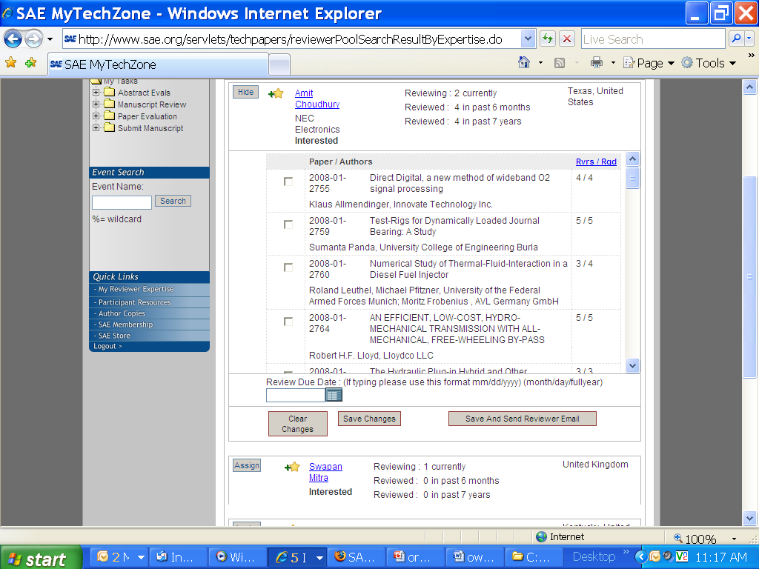
Selecting Reviewers at Session Level
Notes:
After searching by name or expertise, you will receive a results page like this. By clicking the Assign button, you may select any number of the papers in your session to be assigned to the given reviewer (use the checkboxes on the left side

Slide 21
Add Review Due Date
Organizers can add themselves or their co-organizers to review
Automatic notification sent via email
Notes:
Organizers can add themselves or their co-organizers to review technical papers.
Once selected, enter a review due date, then click Save and Send Reviewer Email. The reviewer selected will be invited to review every checked paper.
You may also edit the standard letter of invitation to review if you now the reviewer.
Included in the invitation is a user id login hint for the reviewer.
You as the organizer will copied on the review invitation.

Slide 22
Releasing Results to Authors
Organizer should send a message to the author advising of expectations
PRIORITY
Must Make Comments
viewable to the author/save
Submit review
to Author
Automatic notification sent via email
Notes:
You have the ability to edit the comments by the reviewers, if necessary, before making them viewable. For example, inappropriate and inflammatory comments, remarks, etc)
Review results can be released one at a time or after all three reviews are complete.
Here you will see the difference on the monitor reviews screen before/after releasing the review results.
Provide expectations to author using the “send email to author tab” (due date for revised manuscript)
Organizer Action: Papers will major modifications must be sent back to the reviewers for re-review and rescore after a revised manuscript is uploaded.

Slide 23
Approving Papers for Publication
Click on the header to find out about SAE Journals
Automatic notification sent via email
Notes:
Once reviews are completed, you must go to the Approval tab at the session level, where all papers that are eligible for publication approval will be displayed.
Once you select Yes under Publish, you will be asked to make a recommendation either for or against the paper’s inclusion in SAE’s Journals (based on the total weighted score).
Final determination for Journal selection will be made by the Journal Editors.

Slide 24
Final Manuscript Upload by Authors
Notes:
Authors cannot upload their final approval manuscript until the organizer approves the paper for publication.
Once the author uploads their final approved manuscript, no changes can be made to the paper.

Slide 25
Presentation Order
Notes:
Organizers should provide the session line-up or batting order for their session. As an organizer you can also move papers from one part of your session to another. To enable session ordering, click the enable link at the top. By moving the up/down arrows, you can place the papers in the order in which you want them presented. Organizer can click the save changes link and come back later to finish up the ordering if you do not complete the task at one time.
Once the ordering is complete and you wish to make no further updated, click the session ordering complete link. This will notify SAE staff to assign times and will lock your editing of the ordering.

Slide 26
Session Home Features
Notes:
Take a moment to notice all the different things that you can accomplish from the session home page… it’s a snapshot of where you’re at in the review process.
Also from your initial login page in MyTechZone you are able to download, print or save a participant confirmation letter if you need supporting documentation to help with your travel plans.

Slide 27
Session Level Grouping Feature
Notes:
Using the grouping feature, organizers can sub-divide papers by topics or by organizer area of responsibility. Once they click the grouping final link, an email is sent to the staff rep who divides the papers in the SAE database.

Slide 28
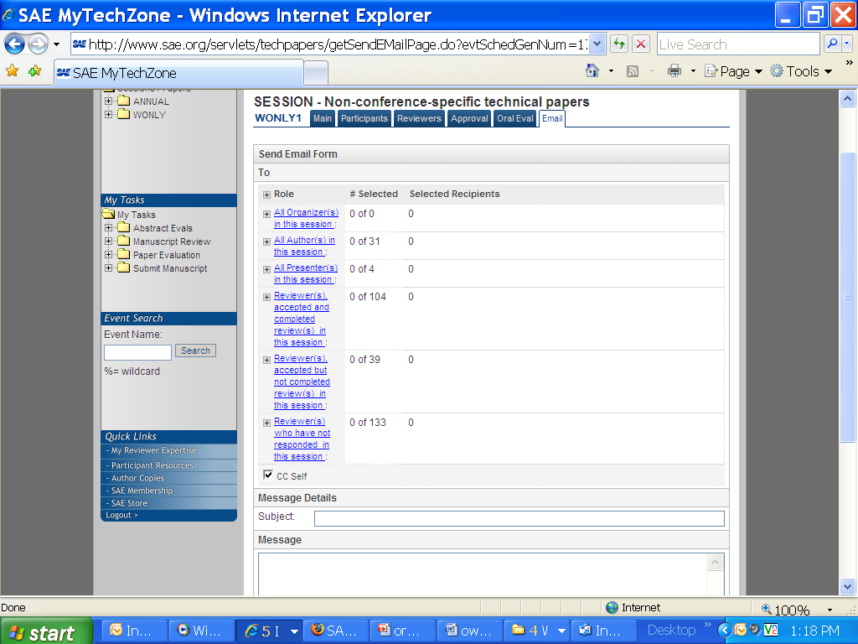
Session Level Email Feature
Notes:
Using the email tab, you can send out mass emails to any group or subset of people associated with your session.

Slide 29
Progress Tab
Notes:
From the progress tab from each individual paper you can now view the details for a specific paper.

Slide 30
Author Bio & Power Point
Notes:
Authors have the ability to upload both their biography forms and their Power Point presentation prior to the meeting. We ask that this be done no later than 3 weeks prior to the meeting. Once uploaded you will see that from the paper home page for each paper.

Slide 31
Preparing for On-Site
Confirm all speakers will be attending
Request presentations in advance
Review each presentation for appropriate length and commercialism
Presenters should bring their final presentation on-site with them
Send instructions to presenters noting these guidelines
Notes:
Review each presentation for appropriate length and commercialism
Typical rule of thumb is one slide per minute
Check SAE website for a list of standard AV equipment (i.e. laptops in all session rooms)

Slide 32
On-Site
Pick up your session chair packet from SAE staff.
Meet with presenters 30 minutes prior to start of session.
Encourage speakers to sit near the front
Limit the introduction of the speaker to name, affiliation and title of talk.
If the speaker does not sense their time is almost over, give them other cues.
Turn in your peak session count form.
Complete oral evaluation ratings in MyTechZone

Slide 33
Oral Presentation Score Entry
For most meetings, computers are provided in registration or the participant lounges to enter scores from oral evaluation cards. All scores and recommendations for awards are entered in www.sae.org/mytechzone.
Notes:
Here, the organizer may enter the scores returned from the onsite oral presentation evaluation forms. Each presenter may have any number of scores – all integers from 1 to 10 – and if all scores in a row are filled, a further row of entry blanks will appear. If you receive more than 10 cards after the 10th score is entered a 2nd blank link will appear.
Additionally, the user may nominate a presenter or presenters for the Award for Excellence in Oral Presentation.
As always, the Submit button in the lower right corner must be clicked to save the user’s work.
Activity chairs will make final selections.

Slide 34
THANK YOU!
Questions?
Contact SAE Customer Service
CustomerService@sae.org
1-877-606-7323
724-776-4970
Notes:
Thank you for your time and attention! If you have any questions about the process, or the online system, please feel free to contact SAE at the e-mail address or phone number shown here.

